Slide 1

Compiler construction
Sir Syed University of Engineering & Technology, Karachi
Department of Computer Science
Cs-310
Dr. Anam Akbar

Slide 2
Intermediate code generation
If we generate machine code directly from source code then. for n target machine we will have optimizers and n code generator
but if we will have a machine-independent intermediate code, we will have only one optimizer. Intermediate code can be either language-specific (e.g., Bytecode for Java) or language independent (three-address code).
The following are commonly used intermediate code representations:
Postfix Notation
Three-Address Code
Syntax Tree

Slide 3
Intermediate code generation
Postfix Notation
Also known as reverse Polish notation or suffix notation.
Places the operator at the right end as ab +.
No parentheses are needed in postfix notation because the position and arity (number of arguments) of the operators permit only one way to decode a postfix expression. In postfix notation, the operator follows the operand.
Example 1: The postfix representation of the expression (a + b) * c is : ab + c * Example 2: The postfix representation of the expression (a – b) * (c + d) + (a – b) is : ab – cd + *ab -+

Slide 4
Intermediate code generation
Why Postfix?
Because Postfix operators use values to their left, any values involving computations will already have been calculated as we go left-to-right, and so the order of evaluation of the operators is not disrupted in the same way as in Prefix expressions.
Benefits:
Postfix has a number of advantages over infix for expressing algebraic formulas.
-First, any formula can be expressed without parenthesis.
-Second, it is very convenient for evaluating formulas on computers with stacks.
Third, infix operators have precedence.
For example, we know that a * b + c means (a * b) + c and not a * (b + c),
because multiplication has been defined to have precedence over addition. Postfix eliminates this nuisance.

Slide 5
Intermediate code generation
One evaluates the postfix expression by the following algorithm:
1. Look at the next symbol. If it is a variable, push its value onto the stack.
2. If the next symbol is an operator, pop the top two items off of the stack, perform the operator on the two symbols, by next_to_last operator last.
3. If there is still symbols left, go to step 1.
4. Terminate with the evaluation of the expression being at the top of the stack.

Slide 6
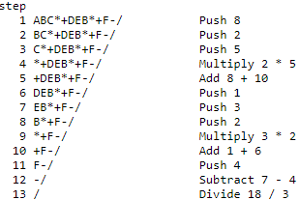
Intermediate code generation
Suppose we have the expression in infix of (A+B*C)/(D+E*B-F) where the values of A, B, C, D, E, and F are 8, 2, 5, 1, 3, and 4 respectively.
The corresponding postfix expression for the infix formula is ABC*+DEB*+F-/

Slide 7
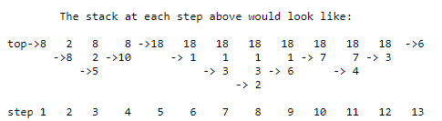
Intermediate code generation

Slide 8
Intermediate code generation
Three-Address Code:
-can be easily converted to machine code.
-It makes use of at most three addresses and one operator to represent an expression and the value computed at each instruction is stored in temporary variable generated by compiler.
-The compiler decides the order of operation given by three address code.
Implementation of Three Address Code : There are 3 representations of three address code namely
Quadruple
Triples
Indirect Triples

Slide 9
Intermediate code generation
Quadruple – structure with 4 fields namely op, arg1, arg2 and result.
Advantage –
Easy to rearrange code for global optimization.
One can quickly access value of temporary variables using symbol table.
Disadvantage –
Contain lot of temporaries.
Temporary variable creation increases time and space complexity.

Slide 10
Intermediate code generation
Example-1: Convert the expression a * – (b + c) into three address code.

Slide 11
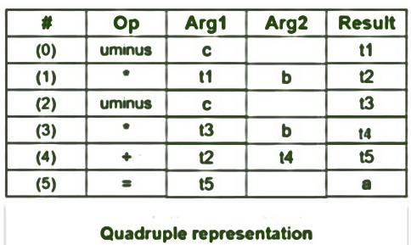
Intermediate code generation
Example-1: Consider expression a = b * – c + b * – c The three address code is:
t1 = uminus c
t2 = b * t1
t3 = uminus c
t4 = b * t3
t5 = t2 + t4
a = t5

Slide 12
Intermediate code generation
2. Triples –
-Structure with 3 fields namely op, arg1, arg2
-No extra temporary variable to represent a single operation
-when a reference to another triple’s value is needed, a pointer to that triple is used.
Disadvantage –
Temporaries are implicit and difficult to rearrange code.
It is difficult to optimize because optimization involves moving intermediate code. When a triple is moved, any other triple referring to it must be updated also. With help of pointer one can directly access symbol table entry.

Slide 13
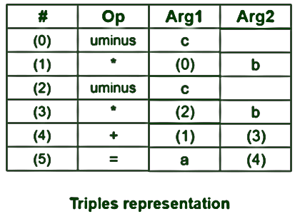
Intermediate code generation
Example – Consider expression a = b * – c + b * – c
t1 = uminus c
t2 = b * t1
t3 = uminus c
t4 = b * t3
t5 = t2 + t4
a = t5

Slide 14
Intermediate code generation
3. Indirect Triples –
-Makes use of pointer to the listing of all references to computations which is made separately and stored. Its similar in utility as compared to quadruple representation but requires less space than it. Temporaries are implicit and easier to rearrange code.

Slide 15
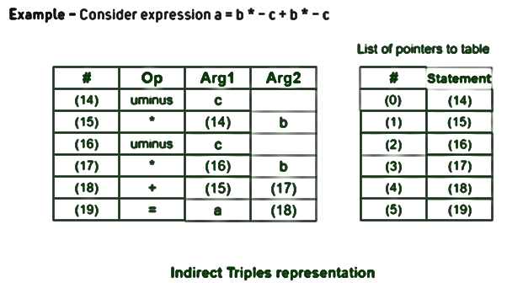
Intermediate code generation

Slide 16
Intermediate code generation
Detection of a Loop in Three Address Code
-Loop optimization is the phase after the Intermediate Code Generation.
-The main intention of this phase is to reduce the number of lines in a program.
-In any program majority of the time is spent by any program is actually inside the loop for an iterative program.
In the case of the recursive program a block will be there and the majority of the time will present inside the block..

Slide 17
Intermediate code generation
Detection of a Loop in Three Address Code
-Loop Optimization –
To apply loop optimization we must first detect loops.
For detecting loops we use Control Flow Analysis(CFA) using Program Flow Graph(PFG).
To find program flow graph we need to find Basic Block

Slide 18
Intermediate code generation
Detection of a Loop in Three Address Code
Basic Block
A basic block is a sequence of three address statements where control enters at the beginning and leaves only at the end without any jumps or halts.
Finding the Basic Block In order to find the basic blocks, we need to find the leaders in the program. Then a basic block will start from one leader to the next leader but not include the next leader. This means if you find out that line no 1 is a leader and line no 15 is the next leader, then the line from 1 to 14 is a basic block, but not including line no 15.

Slide 19
Intermediate code generation
Identifying leader in a Basic Block –
First statement is always a leader
Statement that is target of conditional or un-conditional statement is a leader
Statement that follows immediately a conditional or un-conditional statement is a leader
fact(x)
{
int f = 1;
for (i = 2; i <= x; i++)
f = f * i;
return f;
}

Slide 20
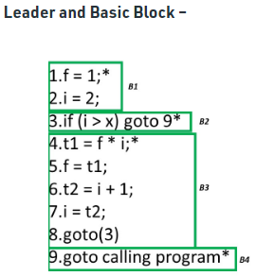
Intermediate code generation
Three Address Code of the above C code:
f = 1;
i = 2;
if (i > x) goto 9
t1 = f * i;
f = t1;
t2 = i + 1;
i = t2;
goto(3)
goto calling program

Slide 21
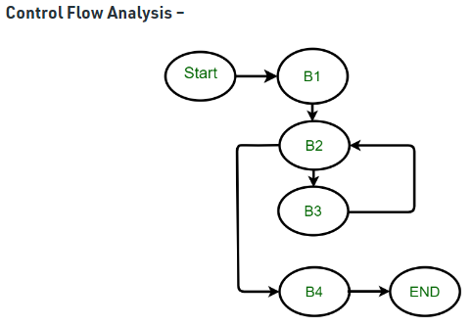
Intermediate code generation

Slide 22
Intermediate code generation
-If the control enter B1 there is no other option after B1,It has to enter B2.
-Now, if control enters B2, then depending on the condition control will flow, if the condition is true we are going to line no 9, which means 9 is nothing but B4.
-But if the condition is false control goes to the next block B3. After B3, there is no condition at all we are direct goes to 3rd statement B2. Above control flow graph have a cycle between B2 and B3 which is nothing but a loop.

Slide 23
Code Optimization in Compiler Design
When to Optimize?
Why Optimize?

Slide 24
Code Optimization in Compiler Design
Answer: 01 Optimization of the code is often performed at the end of the development stage since it reduces readability and adds code that is used to increase the performance.
Answer: 02
1-Reduce the space consumed and increases the speed of compilation.
2-An optimized code often promotes re-usability.

Slide 25
Code Optimization in Compiler Design
Types of Code Optimization:
-Machine Independent Optimization: This code optimization phase attempts to improve the intermediate code to get a better target code as the output. The part of the intermediate code which is transformed here does not involve any CPU registers or absolute memory locations.
-Machine Dependent Optimization: Machine-dependent optimization is done after the target code has been generated and when the code is transformed according to the target machine architecture. It involves CPU registers and may have absolute memory references rather than relative references. Machine-dependent optimizers put efforts to take maximum advantage of the memory hierarchy.

Slide 26
Code Optimization in Compiler Design
Types of Code Optimization:
Code Optimization is done in the following different ways:
1. Compile Time Evaluation
2. Variable Propagation
3. Constant Propagation
4. Constant Folding
5. Copy Propagation
6. Common Sub Expression Elimination
7. Dead Code Elimination
8. Unreachable Code Elimination
9. Function Inlining
10. Function Cloning
11. Induction Variable and Strength Reduction

Slide 27
Code Optimization in Compiler Design
Types of Code Optimization:
Code Optimization is done in the following different ways:
Compile Time Evaluation
(i) A = 2*(22.0/7.0)*r
Perform 2*(22.0/7.0)*r at compile time.
(ii) x = 12.4
y = x/2.3
Evaluate x/2.3 as 12.4/2.3 at compile time.
2. Variable Propagation
//Before Optimization
c = a * b
x = a
till
d = x * b + 4
//After Optimization
c = a * b
x = a
till
d = a * b + 4

Slide 28
Code Optimization in Compiler Design
Types of Code Optimization:
3. Constant Propagation
If the value of a variable is a constant, then replace the variable with the constant. The variable may not always be a constant.
(i) A = 2*(22.0/7.0)*r
Performs 2*(22.0/7.0)*r at compile time.
(ii) x = 12.4
y = x/2.3
Evaluates x/2.3 as 12.4/2.3 at compile time.
(iii) int k=2;
if(k) go to L3;
It is evaluated as :
go to L3 ( Because k = 2 which implies condition is always true)

Slide 29
Code Optimization in Compiler Design
Types of Code Optimization:
4. Constant Folding
#define k 5
x = 2 * k
y = k + 5
This can be computed at compile time and the values of x and y are :
x = 10
y = 10
Note: Difference between Constant Propagation and Constant Folding:
In Constant Propagation, the variable is substituted with its assigned constant where as in Constant Folding, the variables whose values can be computed at compile time are considered and computed.

Slide 30
Code Optimization in Compiler Design
Types of Code Optimization:
5. Copy Propagation
-It is extension of constant propagation.
-After a is assigned to x, use a to replace x till a is assigned again to another variable or value or expression.
-It helps in reducing the compile time as it reduces copying.
//Before Optimization
c = a * b
x = a
till
d = x * b + 4
//After Optimization
c = a * b
x = a
till
d = a * b + 4

Slide 31
Code Optimization in Compiler Design
Types of Code Optimization:
6. Common Sub Expression Elimination
In the above example, a*b and x*b is a common sub expression.
7. Dead Code Elimination
Copy propagation often leads to making assignment statements into dead code.
A variable is said to be dead if it is never used after its last definition.
In order to find the dead variables, a data flow analysis should be done.
c = a * b
x = a
till
d = a * b + 4
//After elimination :
c = a * b
till
d = a * b + 4

Slide 32
Code Optimization in Compiler Design
Types of Code Optimization:
8. Unreachable Code Elimination
-First, Control Flow Graph should be constructed.
-The block which does not have an incoming edge is an Unreachable code block.
-After constant propagation and constant folding, the unreachable branches can be eliminated.
#include <iostream>
using namespace std;
int main() {
int num;
num=10;
cout << “compiler class!";
return 0;
cout << num; //unreachable code
}
//after elimination of unreachable code
int main() {
int num;
num=10;
cout << “compiler Class!";
return 0;
}

Slide 33
Code Optimization in Compiler Design
Types of Code Optimization:
9. Function Inlining
-Here, a function call is replaced by the body of the function itself.
-This saves a lot of time in copying all the parameters, storing the return address, etc.
#include <iostream>
using namespace std;
inline void displayNum(int num) {
cout << num << endl;
}
int main() {
// first function call
displayNum(5);
// second function call
displayNum(8);
// third function call
displayNum(666);
return 0;
}

Slide 34
Code Optimization in Compiler Design
Types of Code Optimization:
10. Function Cloning
Here, specialized codes for a function are created for different calling parameters.
Example: Function Overloading
11. Induction Variable and Strength Reduction
-An induction variable is used in the loop for the following kind of assignment i = i + constant. It is a kind of Loop Optimization Technique.
-Strength reduction means replacing the high strength operator with a low strength.

Slide 35
Code Optimization in Compiler Design
Example 1 :
Multiplication with powers of 2 can be replaced by shift right operator which is less
expensive than multiplication
a=a*16
// Can be modified as :
a = a<<4
Example 2 :
i = 1;
while (i<10)
{
y = i * 4;
}
//After Reduction
i = 1
t = 4
{
while( t<40)
y = t;
t = t + 4;
}

Slide 36
Code Optimization in Compiler Design
Types of Code Optimization:
Loop Optimization Techniques:
1. Code Motion or Frequency Reduction:
-The evaluation frequency of expression is reduced.
-The loop invariant statements are brought out of the loop
2. Loop Jamming
3. Loop Unrolling

Slide 37
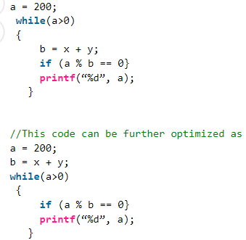
Code Optimization in Compiler Design
Types of Code Optimization:
Loop Optimization Techniques:
1. Code Motion or Frequency Reduction:
-The evaluation frequency of expression is reduced.
-The loop invariant statements are brought out of the loop

Slide 38
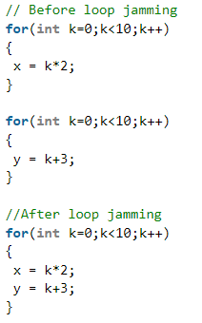
Code Optimization in Compiler Design
Types of Code Optimization:
2. Loop Jamming
Two or more loops are combined in a single loop. It helps in reducing the compile time.

Slide 39
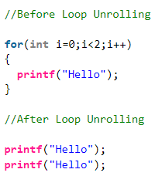
Code Optimization in Compiler Design
Types of Code Optimization:
3. Loop Unrolling:
-It helps in optimizing the execution time of the program by reducing the iterations.
-It increases the program’s speed by eliminating the loop control and test instructions.

Slide 40
Code Optimization in Compiler Design
Types of Code Optimization:
Where to apply Optimization?
Source program
Optimizing the source program involves making changes to the algorithm or changing the loop structures. The user is the actor here.
Intermediate Code
Optimizing the intermediate code involves changing the address calculations and transforming the procedure calls involved. Here compiler is the actor.
Target Code
Optimizing the target code is done by the compiler. Usage of registers, and select and move instructions are part of the optimization involved in the target code.
Local Optimization
Regional Optimization
Global Optimization
Interprocedural Optimization

Slide 41
Code Optimization in Compiler Design
Types of Code Optimization:
Local Optimization
Transformations are applied to small basic blocks of statements. Techniques followed are Local Value Numbering and Tree Height Balancing.
Regional Optimization
Transformations are applied to Extended Basic Blocks. Techniques followed are Super Local Value Numbering and Loop Unrolling.
Global Optimization
Transformations are applied to large program segments that include functions, procedures, and loops. Techniques followed are Live Variable Analysis and Global Code Replacement.
Interprocedural Optimization
As the name indicates, the optimizations are applied inter procedurally. Techniques followed are Inline Substitution and Procedure Placement.

Slide 42
Class Activity-5 Marks
Reading Assignment page number 12-38 from book
Alfred V Aho ; Monica S Lam; Ravi Sethi; Jeffrey D Ullman Compilers: Principles, Techniques , and Tools, India : Pearson India Education Services, 2015
Q#1: Class discussion and Q/A 1 marks
Q#2: Write summary of the following : 4 Marks
-Parallelism & Memory Hierarchies
-Program Translation
-Static & Dynamic Distinction
-Parameter Passing mechamism

